Slide 1
Improved Hardness of Approximating k-Clique under ETH
Bingkai Lin, Xuandi Ren, Yican Sun, Xiuhan Wang
Nanjing U, UC Berkeley, Peking U, Tsinghua U
November 2023

Slide 2
$k$-Clique Problem
Input: an undirected graph $G=\left(V,E\right),$ an integer $k$.
Output: whether there is a clique of size $k$ in $G$.

Slide 3
$k$-Clique Problem
Let $n=|V|$, then $k$-Clique problem is
NP-complete [Karp’72]
does not admit $n^{O(1)}$ time algorithm assuming NP$≠$P
W[1]-complete [Downey-Fellows’95]
does not admit $f\left(k\right)∙n^{O(1)}$ time algorithm assuming W[1]$≠$FPT
Input: an undirected graph $G=\left(V,E\right),$ an integer $k$.
Output: whether there is a clique of size $k$ in $G$.

Slide 4
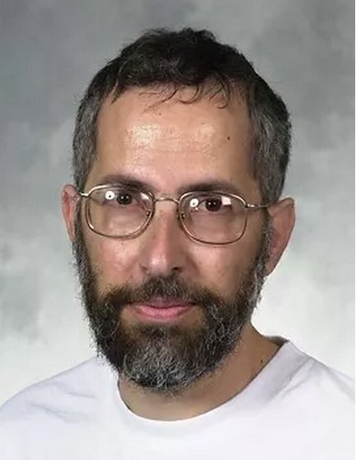
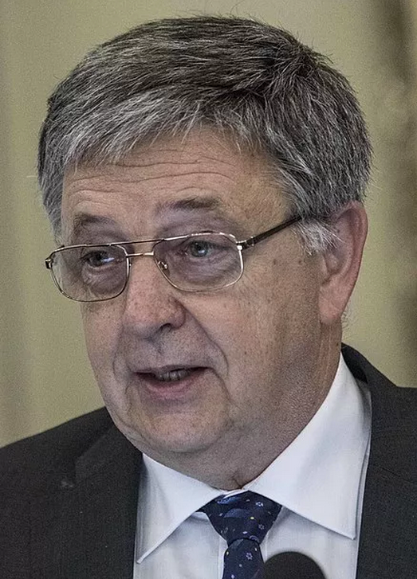
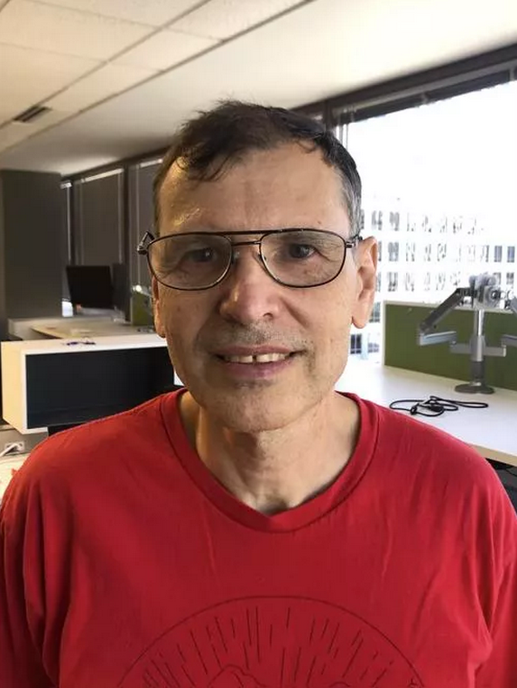
Hardness of Approximating $k$-Clique
A $c$-approximation algorithm for $k$-Clique can:
find a clique of size $k/c$ whenever there is a clique of size $k$ in $G$.
(equivalently) distinguish between: $G$ has a $k$-clique, or $G$ has no $(k/c)$-clique.
Approximating Clique is Almost NP-Complete. FOCS 1991
Test of Time Award
FOCS 2021
Interactive Proofs and the Hardness of Approximating Cliques. JACM 1996
Gödel Prize
2001
Uriel Feige, Shafi Goldwasser, László Lovász, Shmuel Safra, Mario Szegedy
The first polynomial time inapproximability of $k$-Clique
Motivated the discovery of the PCP theorem
Notes:
Equivalently or gap version?

Slide 5
Hardness of Approximating $k$-Clique
After a long line of work [BGLR93, BS94, FGLSS96, Has96, BGS97, Gol98, FK00, Zuc07]:
$n^{1−ε}$-approximating $k$-Clique is NP-hard
New research problem from parameterized complexity
Does $k$-Clique have $f\left(k\right)⋅n^{o(k/γ(k))}$ time $γ(k)$-approximation algorithm?

Slide 6
Hardness of Approximating $k$-Clique
New research problem from parameterized complexity
Does $k$-Clique have $f\left(k\right)⋅n^{o(k/γ(k))}$ time $γ(k)$-approximation algorithm?
Polynomial time inapproximability does not rule out $n^{o(k/γ(k))}$ time algorithm.
Assuming Gap-ETH, the answer is NO. [CCK+’17]
It is more interesting to prove inapproximability under ETH:
From Gap-$k$-Clique to PIH [LRSW’22]
An $f\left(k\right)⋅n^{ω\left(\frac{k}{\log{k}}\right)}$-time lower bound for constant approximating $k$-Clique would imply PIH.
Parameterized Inapproximability Hypothesis [Lokshtanov-Ramanujan-Saurabh-Zehavi’20]:
2CSP with $k$ variables and alphabet size $n$ has no $(1−ε)$-approximation algorithm in $f\left(k\right)⋅n^{O(1)}$ time.

Slide 7
Hardness of Approximating $k$-Clique
New research problem from parameterized complexity
Does $k$-Clique have $f\left(k\right)⋅n^{o(k/γ(k))}$ time $γ(k)$-approximation algorithm?
Polynomial time inapproximability does not rule out $n^{o(k/γ(k))}$ time algorithm.
Assuming Gap-ETH, the answer is NO. [CCK+’17]
It is more interesting to prove inapproximability under ETH:
From Gap-$k$-Clique to PIH [This Work]
An $f\left(k\right)⋅n^{ω\left(\sqrt{k}\right)}$-time lower bound for constant approximating $k$-Clique would imply PIH.
Open problem:
Prove that ETH $⇒$ $k$-Clique has no $f\left(k\right)⋅n^{O(\sqrt{k})}$ time constant approximation
Need a good parameterized gap-producing reduction for $k$-Clique

Slide 8
Parameterized Gap-producing Reduction
Parameterized Gap-producing Reduction $R$
Given a graph $G$ and $k$, R outputs $G′$ and $k′=f(k)$ s.t.
If $G$ contains a $k$-clique, then $G′$ contains a $k$’-clique
If $G$ contains no $k$-clique, then $G′$ contains no $(k′/2)$-clique
$$K_{k}$$
$$⊆$$
$$G$$
$$K_{k′}$$
$$⊆$$
$$G′$$
$$R$$
$$K_{k}$$
$$⊈$$
$$G$$
$$K_{\frac{k^{′}}{2}}$$
$$⊈$$
$$G′$$

Slide 9
Parameterized Gap-producing Reduction $R$
Given a graph $G$ and $k$, R outputs $G′$ and $k′=f(k)$ s.t.
If $G$ contains a $k$-clique, then $G′$ contains a $k$’-clique
If $G$ contains no $k$-clique, then $G′$ contains no $(k′/2)$-clique
$$Gap$$
[Lin’21]
$k^{′}=2^{k^{6}}$
$Gap=O(1)$
$k^{′}=2^{O(k)}$
$Gap=O(1)$
[Lin-Ren-Sun-Wang’22]
$R$ runs in
$f\left(k\right){|G|}^{O(1)}$ time
[Karthik-Khot’22]
$k^{′}=2^{{O(k}^{2})}$
$Gap={\left(k^{′}\right)}^{o(1)}$
$k^{′}=q^{k}$
$Gap=q={\left(k^{′}\right)}^{o(1)}$
[Chen-Feng-Laekhanukit-Liu’23]
$k^{′}=k^{O(\log{\log{k}})}$
$Gap=O(1)$
$R$ runs in
$f(k){\left|G\right|}^{k^{0.54}}$ time
[This work]

Slide 10
Overview of Previous Results
Work | Assumption | Lower Bound for Constant Approximation | Inapproximability Ratio in FPT time
[Lin’21] | W[1]$≠$FPT | no FPT | $$O(1)$$
 | ETH | no $f(k)∙n^{o(\log^{1/6}{k})}$ | /
[Lin-Ren-Sun-Wang’22] | ETH | no $f(k)∙n^{o(\log{k})}$ | any $k^{o(1)}$
[Karthik-Khot’22] | W[1]$≠$FPT | no FPT | any $k^{o(1)}$
[Chen-Feng-Laekhanukit-Liu’23] | W[1]$≠$FPT | no FPT | any $k^{o(1)}$
[This work] | ETH | no $f(k)∙n^{k^{o(1/\log{\log{k}})}}$ | some $k^{1−o(1)}$

Slide 11
$k^{′}=k^{O(\log{\log{k}})}$
$Gap=O(1)$
$R$ runs in
$f(k){\left|G\right|}^{k^{0.54}}$ time
[This work]
Intuition: local to global reduction
$$v_{1}$$
$${∈Σ}_{}$$
$${v′}_{1}$$
$${∈Σ}_{}$$
$$G$$
$$G′$$
$$v_{2}$$
$${∈Σ}_{}$$
$$v_{2}$$
$${∈Σ}_{}$$
Local change
$$k$$
…
…
R
$$v_{k}$$
$${∈Σ}_{1}$$
$$v_{k}$$
$${∈Σ}_{}$$
$$G$$
$$G′$$
Hadamard Code
$$C$$
$$u_{1}$$
$${∈Σ}_{}$$
$${u′}_{1}$$
$${∈Σ}_{}$$
$$u_{2}$$
$${∈Σ}_{}$$
$${u′}_{2}$$
$${∈Σ}_{}$$
$$\left(1−\frac{1}{\left|Σ\right|}\right)n$$
$$n={|Σ|}^{k}$$
…
…
Local change
Global influence
Global influence
$$u_{n}$$
$${∈Σ}_{}$$
$$u_{n}$$
$${∈Σ}_{}$$

Slide 12
$k^{′}=k^{O(\log{\log{k}})}$
$Gap=O(1)$
$R$ runs in
$f(k){\left|G\right|}^{k^{0.54}}$ time
[This work]
$k$-Clique
Vector CSP
Gap-$k′$-Clique
$V_{1}$,…, $V_{k},S_{12},…,S_{k−1k}⊆𝔽^{d}$
$∃v_{1}∈V_{1},…,v_{k}∈V_{k}$,
$∀i,j∈[k],v_{i}+v_{j}∈S_{ij}$ .
$$K_{k}$$
$$⊆$$
$$G$$
$$K_{k′}$$
$$⊆$$
$$G′$$
$V_{1}$,…, $V_{k},S_{12},…,S_{k−1k}⊆𝔽^{d}$
$∀v_{1}∈V_{1},…,v_{k}∈V_{k}$,
$∃i,j∈[k],v_{i}+v_{j}∉S_{ij}$ .
$$K_{k}$$
$$⊈$$
$$G$$
$$K_{k^{′}/2}$$
$$⊈$$
$$G′$$
R

Slide 13
$k^{′}=k^{O(\log{\log{k}})}$
$Gap=O(1)$
$R$ runs in
$f(k){\left|G\right|}^{k^{0.54}}$ time
[This work]
$k$-Clique
Vector CSP
Assume ${V\left(G\right)=U}_{1}∪…∪U_{k}⊆$ $𝔽^{m}$
Pick random matrices $A_{1},…,A_{k}∈𝔽^{d×m}$
$V_{i}=\{A_{i}u :u∈U_{i}\}$
$S_{ij}=\{A_{i}u+A_{j}v:u∈U_{i},v∈U_{j},uv∈E(G)\}$
$V_{1}$,…, $V_{k},S_{12},…,S_{k−1k}⊆𝔽^{d}$
$∃v_{1}∈V_{1},…,v_{k}∈V_{k}$,
$∀i,j∈[k],v_{i}+v_{j}∈S_{ij}$ .
$$K_{k}$$
$$⊆$$
$$G$$
$V_{1}$,…, $V_{k},S_{12},…,S_{k−1k}⊆𝔽^{d}$
$∀v_{1}∈V_{1},…,v_{k}∈V_{k}$,
$∃i,j∈[k],v_{i}+v_{j}∉S_{ij}$ .
Theorem: when $d=O(\log{n/log⁡|𝔽|})$, w.h.p.
$∀$ different$u,u^{′}∈U_{i},A_{i}u≠A_{i}u^{′}$
$∀$ different $\left(v,u\right),\left(v^{′},u^{′}\right)∈U_{i}×U_{j}$
$$A_{i}v+A_{j}u≠A_{i}v^{′}+A_{j}u′$$
$$K_{k}$$
$$⊈$$
$$G$$
Vector CSP with $d=O(\log{n}/\log{|𝔽|})$ is W[1]-hard, and has no $n^{o(k)}$ algorithms under ETH!

Slide 14
$k^{′}=k^{O(\log{\log{k}})}$
$Gap=O(1)$
$R$ runs in
$f(k){\left|G\right|}^{k^{0.54}}$ time
[This work]
$k$-Clique
Vector CSP
Gap-$k′$-Clique
$V_{1}$,…, $V_{k},S_{12},…,S_{k−1k}⊆𝔽^{d}$
$∃v_{1}∈V_{1},…,v_{k}∈V_{k}$,
$∀i,j∈[k],v_{i}+v_{j}∈S_{ij}$ .
$$K_{k}$$
$$⊆$$
$$G$$
$$K_{k′}$$
$$⊆$$
$$G′$$
$V_{1}$,…, $V_{k},S_{12},…,S_{k−1k}⊆𝔽^{d}$
$∀v_{1}∈V_{1},…,v_{k}∈V_{k}$,
$∃i,j∈[k],v_{i}+v_{j}∉S_{ij}$ .
$$K_{k}$$
$$⊈$$
$$G$$
$$K_{k^{′}/2}$$
$$⊈$$
$$G′$$
R

Slide 15
$k^{′}=k^{O(\log{\log{k}})}$
$Gap=O(1)$
$R$ runs in
$f(k){\left|G\right|}^{k^{0.54}}$ time
[This work]
Vector CSP
Gap-$k′$-Clique
$V_{1}$,…, $V_{k},S_{12},…,S_{k−1k}⊆𝔽^{d}$
$∃v_{1}∈V_{1},…,v_{k}∈V_{k}$,
$∀i,j∈[k],v_{i}+v_{j}∈S_{ij}$ .
$$K_{k′}$$
$$⊆$$
$$G′$$
Theorem: Given a Parallel Locally Testable and Decodable Code
$$C:𝔽^{k}→Σ^{k^{′}}$$
There is a reduction from Vector CSP to Gap-$k′$-Clique.
$V_{1}$,…, $V_{k},S_{12},…,S_{k−1k}⊆𝔽^{d}$
$∀v_{1}∈V_{1},…,v_{k}∈V_{k}$,
$∃i,j∈[k],v_{i}+v_{j}∉S_{ij}$ .
$$K_{k^{′}/2}$$
$$⊈$$
$$G′$$

Slide 16
Parallel Locally Testable and Decodable Code
$$d$$
Parallel Locally Testable and Decodable Code
(PLTDC)
$$v_{1}$$
$${∈Σ}_{1}$$
$$v_{1}[1]$$
$$v_{1}[i]$$
$$v_{1}[d]$$
$$v_{1}$$
$${∈Σ}_{1}^{d}$$
$$v_{2}$$
$${∈Σ}_{1}$$
$$v_{2}[1]$$
$$v_{2}[i]$$
$$v_{2}[d]$$
$$v_{2}$$
$${∈Σ}_{1}^{d}$$
$$k$$
$$k$$
…
…
…
…
…
$$v_{k}$$
$${∈Σ}_{1}$$
$$v_{k}[1]$$
$$v_{k}[i]$$
$$v_{k}[d]$$
$$v_{k}$$
$${∈Σ}_{1}^{d}$$
Locally Testable and Decodable Code
$$C$$
$$C$$
$$C^{⊙d}$$
$$u_{1}$$
$${∈Σ}_{2}$$
$$u_{1}[1]$$
$$u_{1}[i]$$
$$u_{1}[d]$$
$$u_{1}$$
$${∈Σ}_{2}^{d}$$
$$u_{2}$$
$${∈Σ}_{2}$$
$$u_{2}[1]$$
$$u_{2}[i]$$
$$u_{2}[d]$$
$$u_{2}$$
$${∈Σ}_{2}^{d}$$
$$n$$
…
$$n$$
…
…
…
…
$$u_{n}$$
$${∈Σ}_{2}$$
$$u_{n}[1]$$
$$u_{n}[i]$$
$$u_{n}[d]$$
$$u_{n}$$
$${∈Σ}_{2}^{d}$$

Slide 17
Parallel Locally Testable and Decodable Code
$$d$$
Parallel Locally Testable and Decodable Code
(PLTDC)
$$v_{1}$$
$${∈Σ}_{1}$$
$$v_{1}[1]$$
$$v_{1}[i]$$
$v_{1}[d]$
$$v_{1}$$
$${∈Σ}_{1}^{d}$$
$$v_{2}$$
$${∈Σ}_{1}$$
$$v_{2}[1]$$
$$v_{2}[i]$$
$$v_{2}[d]$$
$$v_{2}$$
$${∈Σ}_{1}^{d}$$
$$k$$
$$k$$
…
…
…
…
…
$$v_{k}$$
$${∈Σ}_{1}$$
$$v_{k}[1]$$
$$v_{k}[i]$$
$$v_{k}[d]$$
$$v_{k}$$
$${∈Σ}_{1}^{d}$$
Locally Testable and Decodable Code
$$C$$
$$C$$
$$C^{⊙d}$$
$$u_{1}$$
$${∈Σ}_{2}$$
$$u_{1}[1]$$
$$u_{1}[i]$$
$$u_{1}[d]$$
$$u_{1}$$
$${∈Σ}_{2}^{d}$$
Key Features:
Parallel local testability
2-Query parallel local decodability for $v_{i}$ and $v_{i}+v_{j}$
Smoothness
Example:
Hadamard Code
$$u_{2}$$
$${∈Σ}_{2}$$
$$u_{2}[1]$$
$$u_{2}[i]$$
$$u_{2}[d]$$
$$u_{2}$$
$${∈Σ}_{2}^{d}$$
$$n$$
…
$$n$$
…
…
…
…
$$u_{n}$$
$${∈Σ}_{2}$$
$$u_{n}[1]$$
$$u_{n}[i]$$
$$u_{n}[d]$$
$$u_{n}$$
$${∈Σ}_{2}^{d}$$

Slide 18
From Vec-CSP to Gap-Clique using PLTDC
PLTDC
Gap-Clique
$$v_{1}$$
$${∈𝔽}_{1}^{d}$$
assignments accepted by the testing query
$$v_{2}$$
$${∈𝔽}_{1}^{d}$$
Vector CSP
Input: $V_{1}$,…, $V_{k},S_{12},…,S_{k−1k}⊆𝔽_{1}^{d}$, distinguish between
(yes) $∃v_{1}∈V_{1},…,v_{k}∈V_{k}$,
$∀i,j∈[k],v_{i}+v_{j}∈S_{ij}$ .
(no) $∀v_{1}∈V_{1},…,v_{k}∈V_{k}$,
$∃i,j∈[k],v_{i}+v_{j}∉S_{ij}$ .
…
$$q_{1}=(u_{r_{11}},u_{r_{12}},u_{r_{13}})$$
$$v_{k}$$
$${∈𝔽}_{1}^{d}$$
$$u_{1}$$
$${∈𝔽}_{2}^{d}$$
Testing
queries
$$q_{2}=(u_{r_{21}},u_{r_{22}},u_{r_{23}})$$
$$u_{2}$$
$${∈𝔽}_{2}^{d}$$
…
Two types of non-Edges
Fails Consistency check
Decoding result violates the Vector CSP constraint
…
…
Decoding
queries
$${∈𝔽}_{2}^{d}$$
$$q_{T}=(u_{r_{T1}},u_{r_{T2}},u_{r_{T3}})$$
$$u_{k^{′}}$$
$T$: # of randomness in local testing

Slide 19
PLTDC from Derivative Code
Recall PLTDC: a code mapping $Σ_{1}^{k}$ to $Σ_{2}^{k′}$, satisfying
Parallel local testability
2-Query parallel local decodability
Derivative Code [Woodruff-Yekhanin’07]: an extension of the Reed-Muller Code
Code | $$k’$$ | $$Σ_{2}$$
Hadamard Code | $${(Σ_{1})}^{k}$$ | $$Σ_{1}$$
Derivative Code with degree 3 | $${\left(Σ_{1}\right)}^{\sqrt[3]{k}}$$ | $${\left(Σ_{1}\right)}^{\sqrt[3]{k}+1}$$
Derivative Code with degree $Θ(\log{k})$ | $$k^{Θ(log{\log{k})}}$$ | $${\left(Σ_{1}\right)}^{k^{0.54}}$$

Slide 20
PLTDC from Derivative Code
Recall PLTDC: a code mapping $Σ_{1}^{k}$ to $Σ_{2}^{k′}$, satisfying
Parallel local testability
2-Query parallel local decodability
Derivative Code [Woodruff-Yekhanin’07]: an extension of the Reed-Muller Code
Fix some finite field $𝔽$ and let $Σ_{1}=𝔽$
Message length $k=\left({m+3 \atop 3}\right)$
a message $\left(a_{1},…,a_{k}\right)↔$ coefficients of an $m$-variate degree-3 polynomial $f$
Block length $k^{′}=𝔽^{m}$
a “truth table” - one symbol for each $x∈$ $𝔽^{m}$
$Σ_{2}=𝔽^{m+1}$
$\left(f\left(x\right),\frac{∂f}{∂x_{1}}\left(x\right),\frac{∂f}{∂x_{2}}\left(x\right),…,\frac{∂f}{∂x_{m}}\left(x\right)\right)$
$$k=\left({m+3 \atop 3}\right)$$
$$k^{′}=𝔽^{m}$$
$$𝔽$$
$$𝔽^{m+1}$$

Slide 21
PLTDC from Derivative Code
$$k=\left({m+3 \atop 3}\right)$$
$$k^{′}=𝔽^{m}$$
$$𝔽$$
$$f∈𝔽^{≤3}[x_{1},…,x_{m}]$$
$$𝔽^{m+1}$$
$$\left(f\left(x\right),\frac{∂f}{∂x_{1}}\left(x\right),\frac{∂f}{∂x_{2}}\left(x\right),…,\frac{∂f}{∂x_{m}}\left(x\right)\right)$$
Fix $x∈$ $𝔽^{m}$and a direction $h∈𝔽^{m}$, consider the function $g(λ)≜f(x+λh)$
$g$ is supposed to be a univariate degree-$3$ polynomial
Given access to the codeword at $(x+λ_{1}h)$ and $(x+λ_{2}h)$, we are able to get
$\left(f\left(x+λ_{1}h\right),\frac{∂f}{∂x_{1}}\left(x+λ_{1}h\right), …,\frac{∂f}{∂x_{m}}\left(x+λ_{1}h\right)\right)$
$\left(f\left(x+λ_{2}h\right),\frac{∂f}{∂x_{1}}\left(x+λ_{2}h\right), …,\frac{∂f}{∂x_{m}}\left(x+λ_{2}h\right)\right)$

Slide 22
PLTDC from Derivative Code
$$k=\left({m+3 \atop 3}\right)$$
$$k^{′}=𝔽^{m}$$
$$𝔽$$
$$f∈𝔽^{≤3}[x_{1},…,x_{m}]$$
$$𝔽^{m+1}$$
$$\left(f\left(x\right),\frac{∂f}{∂x_{1}}\left(x\right),\frac{∂f}{∂x_{2}}\left(x\right),…,\frac{∂f}{∂x_{m}}\left(x\right)\right)$$
Fix $x∈$ $𝔽^{m}$and a direction $h∈𝔽^{m}$, consider the function $g(λ)≜f(x+λh)$
$g$ is supposed to be a univariate degree-$3$ polynomial
Given access to the codeword at $(x+λ_{1}h)$ and $(x+λ_{2}h)$, we are able to get
$\left(f\left(x+λ_{1}h\right),\frac{∂f}{∂x_{1}}\left(x+λ_{1}h\right), …,\frac{∂f}{∂x_{m}}\left(x+λ_{1}h\right)\right)$
$\left(f\left(x+λ_{2}h\right),\frac{∂f}{∂x_{1}}\left(x+λ_{2}h\right), …,\frac{∂f}{∂x_{m}}\left(x+λ_{2}h\right)\right)$
$g\left(λ_{1}\right)$
$g′\left(λ_{1}\right)$
$g\left(λ_{2}\right)$
$g′\left(λ_{2}\right)$

Slide 23
PLTDC from Derivative Code
$$k=\left({m+3 \atop 3}\right)$$
$$k^{′}=𝔽^{m}$$
$$𝔽$$
$$f∈𝔽^{≤3}[x_{1},…,x_{m}]$$
$$𝔽^{m+1}$$
$$\left(f\left(x\right),\frac{∂f}{∂x_{1}}\left(x\right),\frac{∂f}{∂x_{2}}\left(x\right),…,\frac{∂f}{∂x_{m}}\left(x\right)\right)$$
Fix $x∈$ $𝔽^{m}$and a direction $h∈𝔽^{m}$, consider the function $g(λ)≜f(x+λh)$
$g$ is supposed to be a univariate degree-$3$ polynomial
Given access to the codeword at $(x+λ_{1}h)$ and $(x+λ_{2}h)$, we are able to get
$\left(f\left(x+λ_{1}h\right),\frac{∂f}{∂x_{1}}\left(x+λ_{1}h\right), …,\frac{∂f}{∂x_{m}}\left(x+λ_{1}h\right)\right)$
$\left(f\left(x+λ_{2}h\right),\frac{∂f}{∂x_{1}}\left(x+λ_{2}h\right), …,\frac{∂f}{∂x_{m}}\left(x+λ_{2}h\right)\right)$
$g\left(λ_{1}\right)$
$g′\left(λ_{1}\right)$
$g\left(λ_{2}\right)$
$g′\left(λ_{2}\right)$

Slide 24
PLTDC from Derivative Code
$$k=\left({m+3 \atop 3}\right)$$
$$k^{′}=𝔽^{m}$$
$$𝔽$$
$$f∈𝔽^{≤3}[x_{1},…,x_{m}]$$
$$𝔽^{m+1}$$
$$\left(f\left(x\right),\frac{∂f}{∂x_{1}}\left(x\right),\frac{∂f}{∂x_{2}}\left(x\right),…,\frac{∂f}{∂x_{m}}\left(x\right)\right)$$
Fix $x∈$ $𝔽^{m}$and a direction $h∈𝔽^{m}$, consider the function $g(λ)≜f(x+λh)$
$g$ is supposed to be a univariate degree-$3$ polynomial
Given access to the codeword at $(x+λ_{1}h)$ and $(x+λ_{2}h)$, we are able to get
$\left(f\left(x+λ_{1}h\right),\frac{∂f}{∂x_{1}}\left(x+λ_{1}h\right), …,\frac{∂f}{∂x_{m}}\left(x+λ_{1}h\right)\right)$
$\left(f\left(x+λ_{2}h\right),\frac{∂f}{∂x_{1}}\left(x+λ_{2}h\right), …,\frac{∂f}{∂x_{m}}\left(x+λ_{2}h\right)\right)$
$g\left(λ_{1}\right)$
$g′\left(λ_{1}\right)$
$g\left(λ_{2}\right)$
$g′\left(λ_{2}\right)$

Slide 25
PLTDC from Derivative Code
$$k=\left({m+3 \atop 3}\right)$$
$$k^{′}=𝔽^{m}$$
$$𝔽$$
$$f∈𝔽^{≤3}[x_{1},…,x_{m}]$$
$$𝔽^{m+1}$$
$$\left(f\left(x\right),\frac{∂f}{∂x_{1}}\left(x\right),\frac{∂f}{∂x_{2}}\left(x\right),…,\frac{∂f}{∂x_{m}}\left(x\right)\right)$$
Fix $x∈$ $𝔽^{m}$and a direction $h∈𝔽^{m}$, consider the function $g(λ)≜f(x+λh)$
$g$ is supposed to be a univariate degree-$3$ polynomial
Given access to the codeword at $(x+λ_{1}h)$ and $(x+λ_{2}h)$, we are able to get
$\left(f\left(x+λ_{1}h\right),\frac{∂f}{∂x_{1}}\left(x+λ_{1}h\right), …,\frac{∂f}{∂x_{m}}\left(x+λ_{1}h\right)\right)$
$\left(f\left(x+λ_{2}h\right),\frac{∂f}{∂x_{1}}\left(x+λ_{2}h\right), …,\frac{∂f}{∂x_{m}}\left(x+λ_{2}h\right)\right)$
$g\left(λ_{1}\right)$
$g′\left(λ_{1}\right)$
$g\left(λ_{2}\right)$
$g′\left(λ_{2}\right)$

Slide 26
PLTDC from Derivative Code
$$k=\left({m+3 \atop 3}\right)$$
$$k^{′}=𝔽^{m}$$
$$𝔽$$
$$f∈𝔽^{≤3}[x_{1},…,x_{m}]$$
$$𝔽^{m+1}$$
$$\left(f\left(x\right),\frac{∂f}{∂x_{1}}\left(x\right),\frac{∂f}{∂x_{2}}\left(x\right),…,\frac{∂f}{∂x_{m}}\left(x\right)\right)$$
Fix $x∈$ $𝔽^{m}$and a direction $h∈𝔽^{m}$, consider the function $g(λ)≜f(x+λh)$
$g$ is supposed to be a univariate degree-$3$ polynomial
Given access to the codeword at $(x+λ_{1}h)$ and $(x+λ_{2}h)$, we are able to get
$\left(f\left(x+λ_{1}h\right),\frac{∂f}{∂x_{1}}\left(x+λ_{1}h\right), …,\frac{∂f}{∂x_{m}}\left(x+λ_{1}h\right)\right)$
$\left(f\left(x+λ_{2}h\right),\frac{∂f}{∂x_{1}}\left(x+λ_{2}h\right), …,\frac{∂f}{∂x_{m}}\left(x+λ_{2}h\right)\right)$
$g\left(λ_{1}\right)$
$g′\left(λ_{1}\right)$
$g\left(λ_{2}\right)$
$g′\left(λ_{2}\right)$
allows us to solve the coefficients of $g$, then output $g\left(0\right)=f(x)$

Slide 27
Conclusion and Open Problem
Contributions
A framework to prove hardness of gap $k$-Clique
A PLTDC is all you need!
Improved lower bound and inapproximability ratio under ETH
$f(k)⋅n^{k^{Ω(1/\log{\log{k}})}}$ time lower bound for constant approximation
$k^{1−o(1)}$ inapproximability ratio in FPT time
Tighter connection: $f\left(k\right)⋅n^{ω\left(\sqrt{k}\right)}$time lower bound for constant gap $k$-Clique $⇒$ PIH
Open problem
$f\left(k\right)⋅n^{ω\left(\sqrt{k}\right)}$ time lower bound for constant gap $k$-Clique under ETH?
Thank You!

